Slide 1
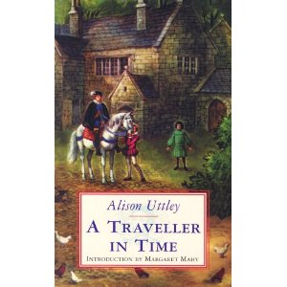
“A Traveller in Time”
Alison Uttley
By
Holly Thompson

Slide 2
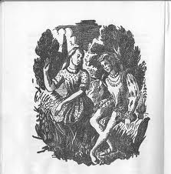
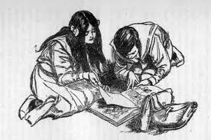
A Traveller In time
The Historical Aspect
This is a fantasy sustained by a strange imaginative realism.
Penelope Tabener who can time travel in time.
One second she is surrounded by her aunt, uncle , brother and sister and the next engrossed in the dangerous time of the Babington plot.

Slide 3
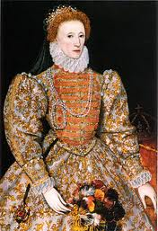
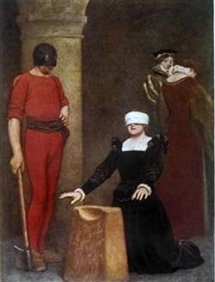
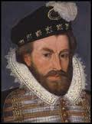
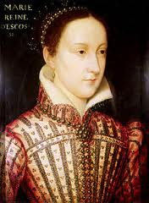
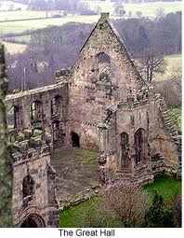
A Traveller In time
The Historical Aspect
Thacker's
Secret tunnels
If they were discovered
They were sure to be
executed.
Queen Elizabeth 1
of England
1586 England
Anthony Babington
Mary Queen of Scots
Wingfield Manor

Slide 4
History
Because I enjoy history as a subject it made this book much more enjoyable, since half of it is spent in the past!
I was glad therefore that I had some background knowledge of The Babington plot so I knew of the references to it.

Slide 5

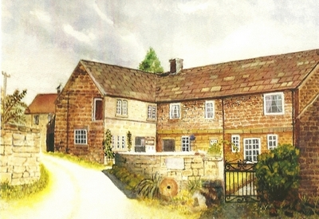



Slide 6
The Time Travelling into History
The Author has so cleverly and skilfully written this book makes the past seem as real to the reader and Penelope as the present.
She really does make you think
You sometimes have to wonder... Is she in the present or the past!
This is not because it is a badly written book just because it is done in such a seamless manner.
It focuses you once more on the book so that your 100% attention is on the following usually important event.

Slide 7
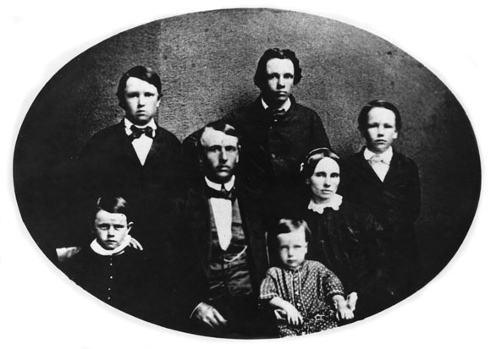
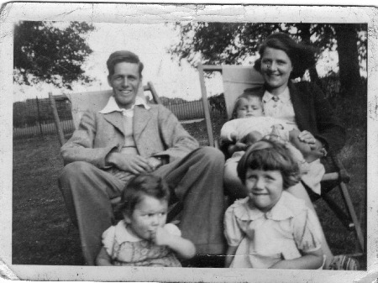
The sense of family connection shines strong in this tale...
1939
1854

Slide 8
The Setting
Mystical
Eerie
Exciting
Both eras have characters that reflect one another.
They also both have the stereotypical goodies and baddies!
The adventure is the page turner.

Slide 9

The Peacefulness of Thacker's which had held the seasons for 500 years, flowed through me , giving me strength and courage as it had done to those others uniting me to them. I knew I had seen them for the last time on this earth, but some day I shall return to be with that brave company of shadows.
Quote

Slide 10
Quote Evaluation
This quote comes at the very end which I think is a fantastic conclusion.
Penelope is recognising that yes they are dead and looking at it as a privilege that she got to see them.
She is also acknowledging that they were brave in their own time and is almost looking forward to reuniting with them in the afterlife.

Slide 11

Conclusion
Even though it was first published in 1939 it is still a fantastic read now in 2012. I would recommend this to anyone wither they like a bit of history or just a great page turner that really will take you back in time.
1939 2012
During the course of this story Thacker's has been described as timeless but I think the book itself is too!!

Slide 12
Thank you !
Do you have any questions?

